Slide 1
System Architecture

Slide 2
https://nndkhoa.github.io/software-design-docs/D05/architecture.html
https://learning.oreilly.com/library/view/software-architecture-patterns/9781098134280/ch02.html#idm46088525263056
https://learning.oreilly.com/library/view/fundamentals-of-software/9781098175504/

Slide 3
Architecture Classification
Monolithic Architectures
Distributed Architectures

Slide 4
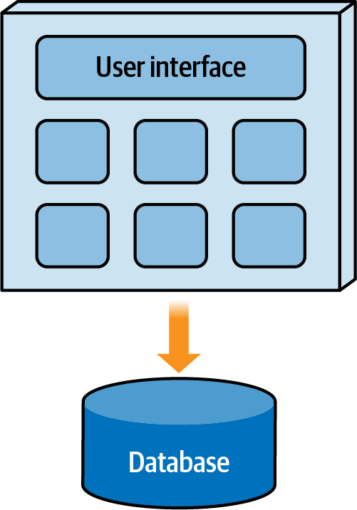
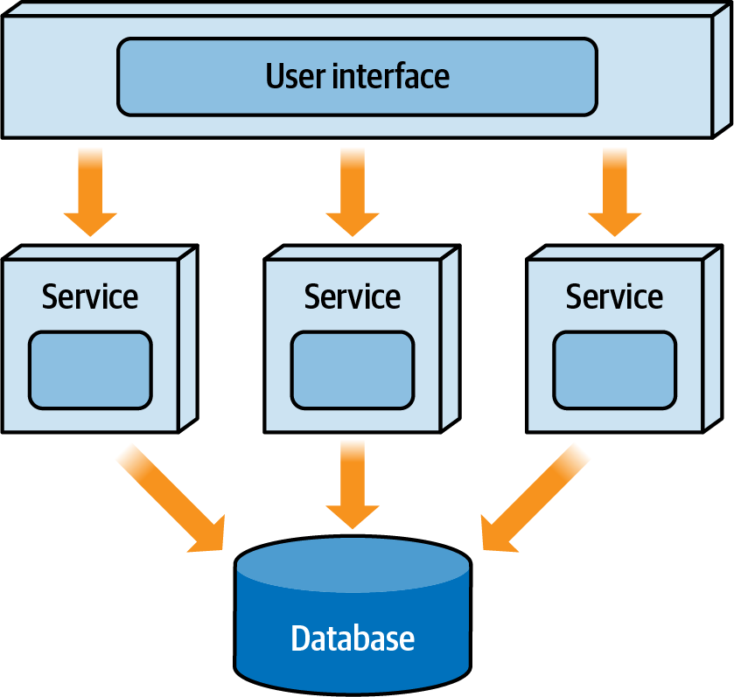
Monolithic Architectures Distributed Architectures

Slide 5
Architecture Partitioning
Technical Partitioning
Domain Partitioning

Slide 6
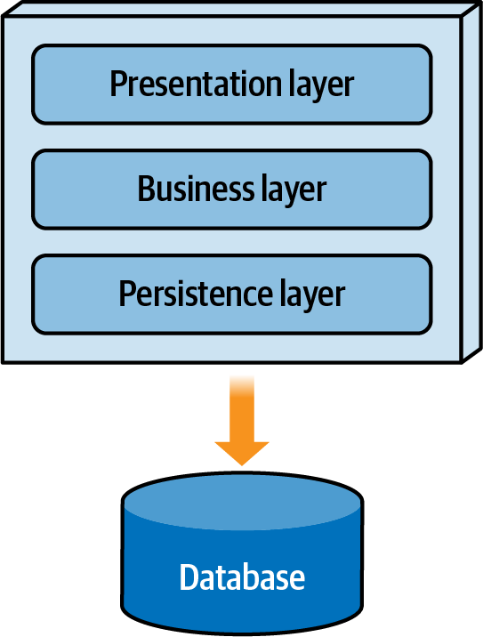
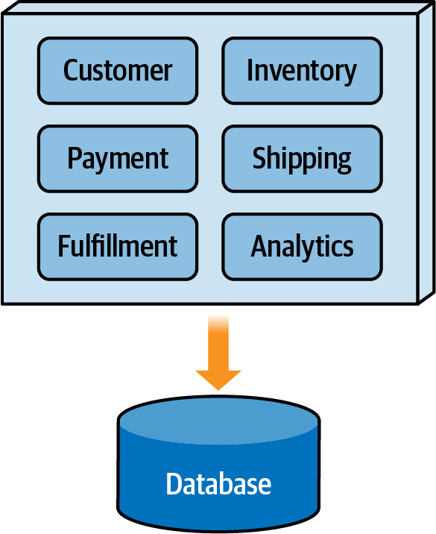

Slide 7
Architecture patterns
MVC vs MVP vs MVVM
CQRS (Command-Query-Responsibility-Segregation)
Hexagonal Architecture vs Clean Architecture vs Onion Architecture

Slide 8
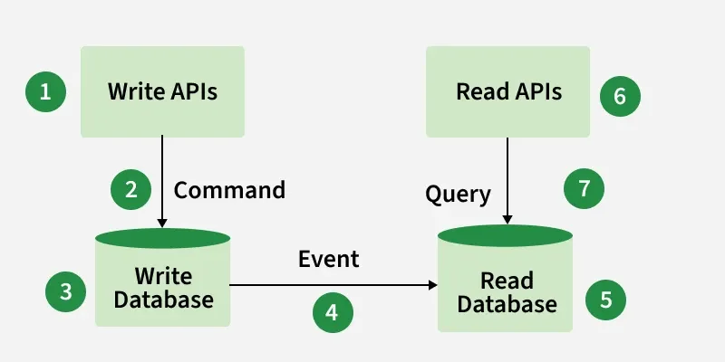
CQRS
Commands, which handle state-changing
operations such as insert, update, and delete.
Queries, which retrieve data
without modifying the system state.

Slide 9
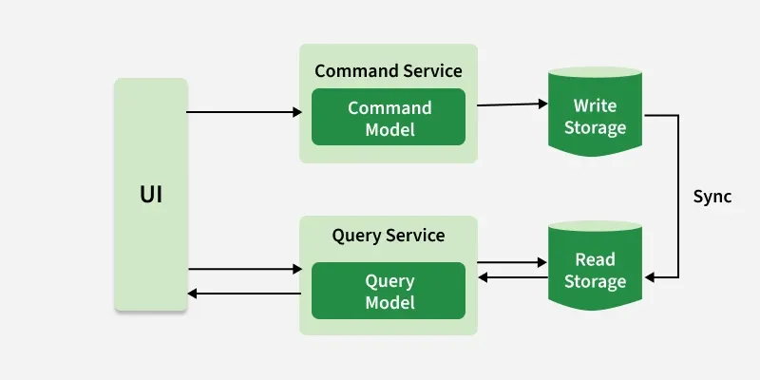
CQRS

Slide 10
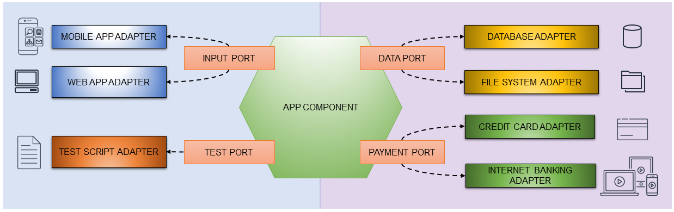
Hexagonal Architecture

Slide 11
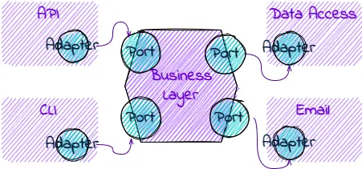
Hexagonal Architecture

Slide 12
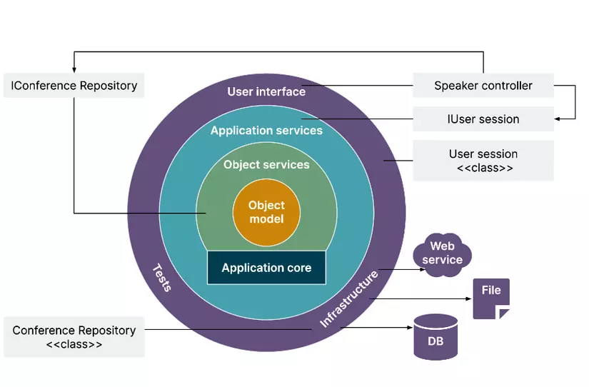
Onion ARCHITECTURE

Slide 13
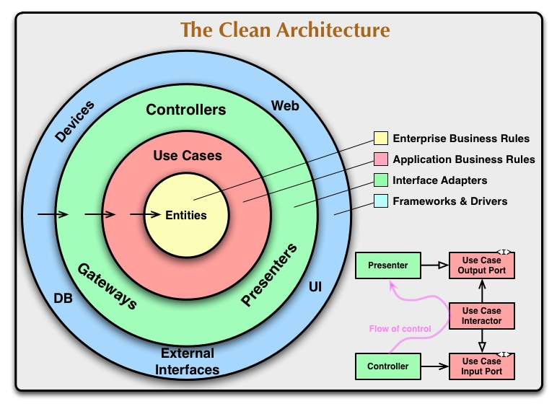
CLEAN ARCHITECTURE

Slide 14
